Slide 1
Pulsed Light Treatment For Extended Shelf Life

Slide 2
Why Pulsed Light?
All microorganisms, with the exception of Mad Cow Disease, contain DNA. Therefore, a technology that destroys DNA will provide an effective means of sanitization, decontamination and sterilization.
Because high peak power pulsed UV light kills DNA and inactivates all types of microorganisms, including fungal yeasts and molds, bacteria, rickettsiae, mycoplasma, and viruses, it is classified as a sterilization agent.
It can be used in all applications that currently utilize continuous wave UV mercury vapor arc lamps with minimum energy consumption.
It is environmentally friendly and FDA approved, which fits easily into almost any process due to his small footprint. There is no heat generated during the sterilization, so no condensation, or modification of the sensorial features of the product.

Slide 3
Application
Trials were run with Arnold’s Multigrain bread from Greenwich Bakery.
Mold growth was negative for bread wrapped or unwrapped at 5 ft/min speed at 3 pulses per second.
Bread was flipped to treat the whole surface.
Two repetitions were run for each test.

Slide 4
Trial Results

Slide 5
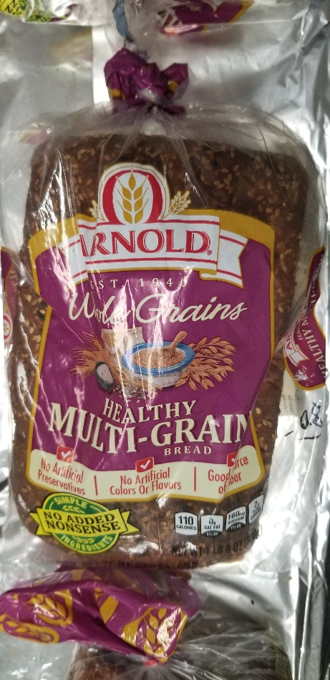
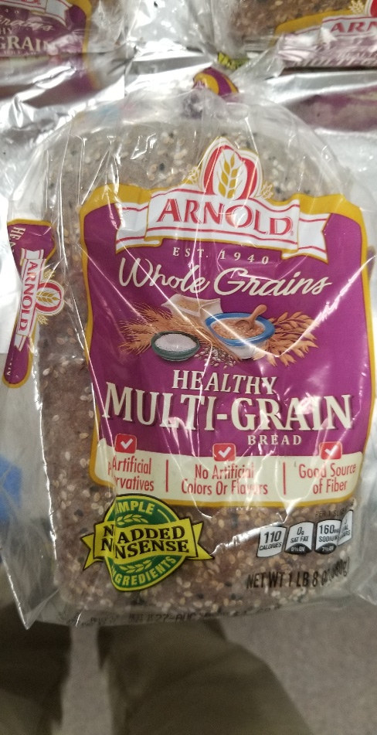
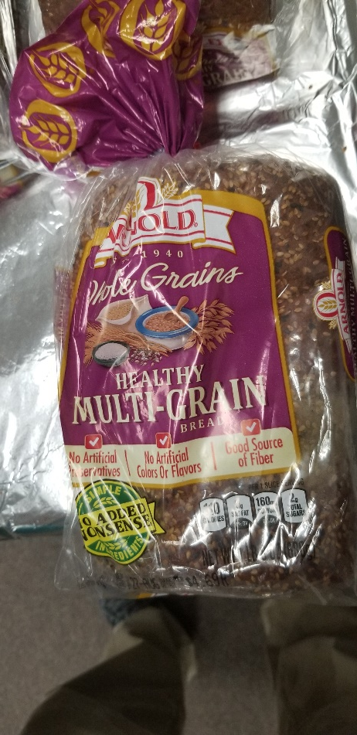
Trial Images
Exposed in the Wrap- Flipped Both Sides at 10 ft/min (Day 29)
Exposed Outside of Bag-Flipped Both Sides at 10 ft/min (Day 18)
Control (Day 18)

Slide 6
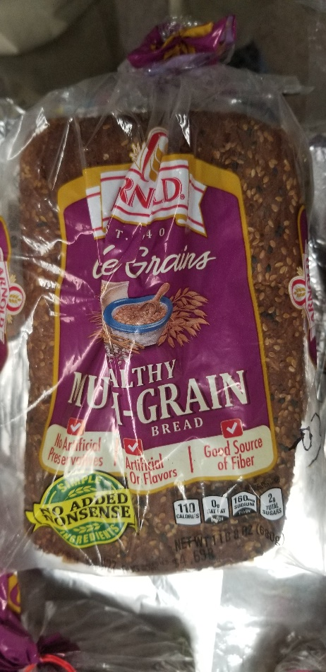
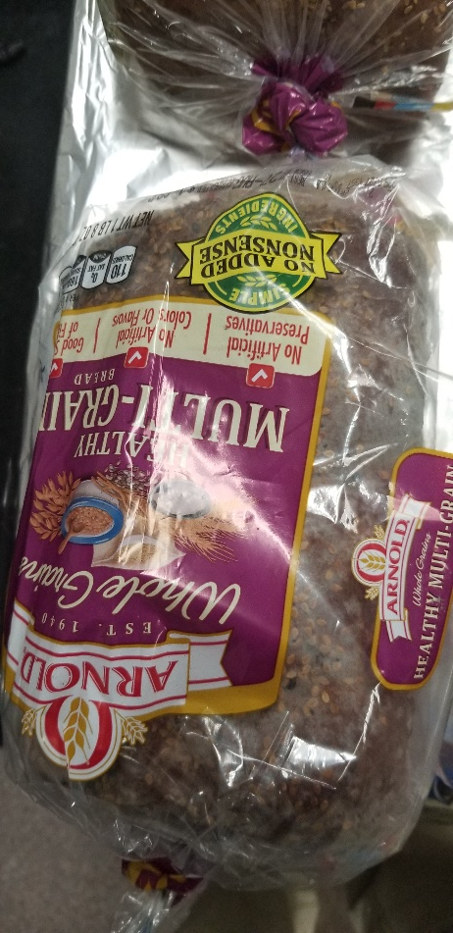
Trial Images
Exposed in the Wrap- Flipped Both Sides at 5 ft/min (Day 29)
Control (Day 18)
Exposed in the Wrap- Flipped Both Sides at 5 ft/min (Day 29)

Slide 7
Z-2000
The Z-2000 is a completely integrated stand-alone system including stainless steel enclosure and Electro-Optical system and Pure Pulse™ Lamp
Features:
High irradiance: 1.27 J/cm² per pulse
High peak power: >1.5 kW/cm²
Continuous spectrum UV-VIS-IR
Achieve 3 to 6 Log Reduction
No warm up time
No harsh chemicals or mercury
Air cooled lamp enclosures
Dual lamps
Light Intensity Monitor
Low maintenance
CE Marked
Disinfect through clear packaging

Slide 8
US FDA APPROVAL

Slide 9
Thank You
Xenon Corporation
Wilmington, Massachusetts 01887 USA
www.xenoncorp.com

