Slide 1


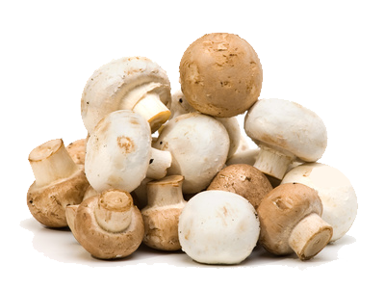
XENON Pulsed Light
Increasing Vitamin D in Mushrooms
Welcome to our Waiting Room…
Presentation By CEO Louis Panico
With Q&A by
VP of Emerging Technologies,
Joe Peirce

Slide 2
XENON Pulsed Light
Increasing Vitamin D in Mushrooms
Presentation By CEO Louis Panico
With Q&A by
VP of Emerging Technologies,
Joe Peirce

Slide 3
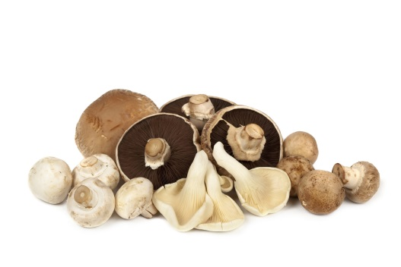
ABOUT VITAMIN D
Recommended Daily Allowance for Vitamin D
Vitamin D is essential for good
health.
Most countries have a problem with Vitamin D deficiency.
Vitamin D is generated by the skin when exposed to sunlight.
In places that do not get much sunlight or societies that spend time indoors, Vitamin D needs to be supplemented.
The older we get, the more Vitamin D we require.
Not many foods naturally contain Vitamin D and the quantity is small.
Age | Male | Female | Pregnancy | Lactation
0–12 mo.* | 400 IU | 400 IU
 | (10 mcg) | (10 mcg)
1–13 yrs. | 600 IU | 600 IU
 | (15 mcg) | (15 mcg)
14–18 yrs. | 600 IU | 600 IU | 600 IU | 600 IU
 | (15 mcg) | (15 mcg) | (15 mcg) | (15 mcg)
19–50 yrs. | 600 IU | 600 IU | 600 IU | 600 IU
 | (15 mcg) | (15 mcg) | (15 mcg) | (15 mcg)
51–70 yrs. | 600 IU | 600 IU
 | (15 mcg) | (15 mcg)
>70 yrs. | 800 IU | 800 IU
 | (20 mcg) | (20 mcg)
Source : NIH Office of dietary supplement

Slide 4
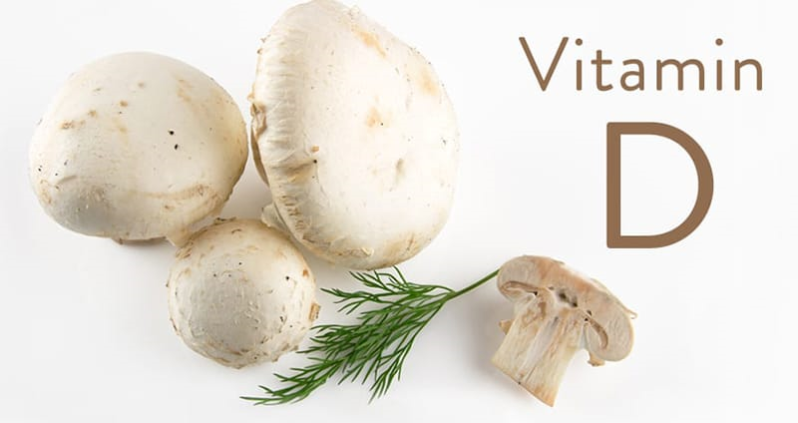
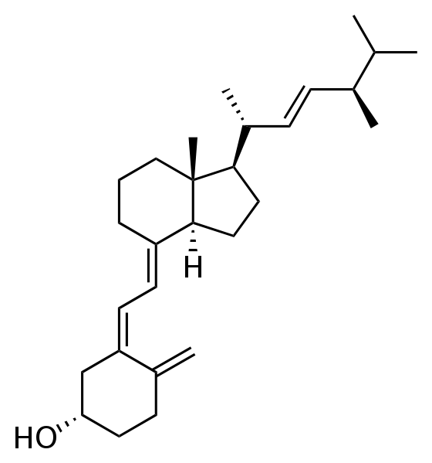
Vitamin D₂
There are many types of Vitamin D the two major forms are Vitamin D₂ and Vitamin D_{3.}
Vitamin D is a group of secosteroids.
Vitamin D₂ Formula C₂₈H₄₄O.
Chemical Name Ergocalciferol.
Ergocalciferol (Vitamin D₂)

Slide 5
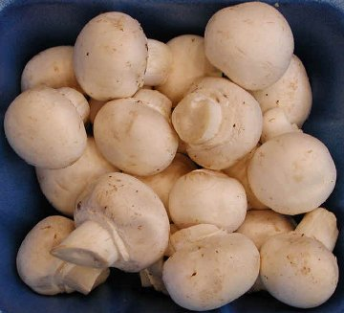
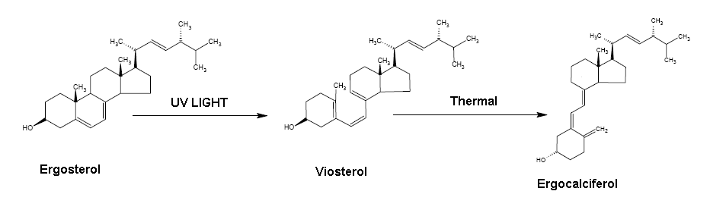
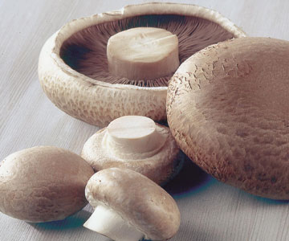
Mushrooms
Mushrooms and other fungi contain an important precursor to D₂ − Ergosterol.
When exposed to UV Light Ergosterol converts to Ergocalciferol.
A large amount of Vitamin D can be produced.

Slide 6
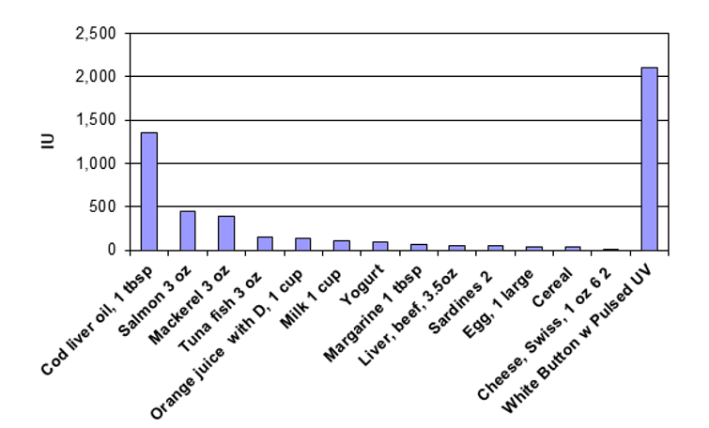
Vitamin D in Mushrooms Enhanced with Pulsed Light
Dietary Sources of Vitamin D

Slide 7
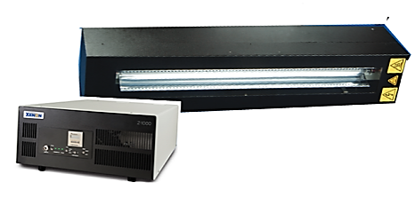
Enhancement is Easy
Convenient. Can be done post harvest.
Flexible. Usually done before packaging.
Simple. Requires installation of a Flash lamp system on a conveyor line.
Fast. Requires 1 to 3 pulses from flash lamp which can be delivered in less than a second.
Chemical-free enhancement; no additives.
Process takes place in air.
A large amount of Vitamin D can be produced when exposed to Pulsed Light.

Slide 8
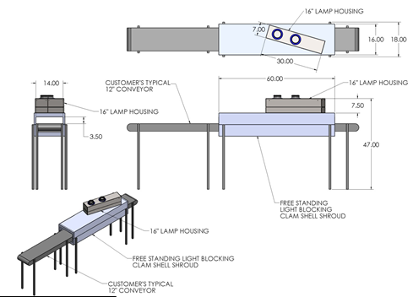
Ease of Implementation into Production Line
The lamp housing is mounted over a user-designed tunnel as the mushrooms are moved under the flashing lamp in a mushroom till on a conveyor belt.
The lamp generates high-energy light pulses with a wavelength that approximates that of sunlight.
The controller unit provides all power for the flashlamp as well as controls the light pulse shape, pulse energy and pulse rate.

Slide 9
Why XENON Pulsed Light?
Cooling
Time
Cooling
Time
Cooling
Time
Delivers lots of Photons fast.
High-peak power, fast pulse leads to greater penetration depth.
Short-pulse duration, mercury-free means very little temperature rise.
  We don’t cook the food.
  Allow plenty of time for cooling.
Complete spectrum in close proximity to sunlight. Used to test solar panels.
FDA Approved for food processing.
Instant on/off for enhanced process control.

Slide 10
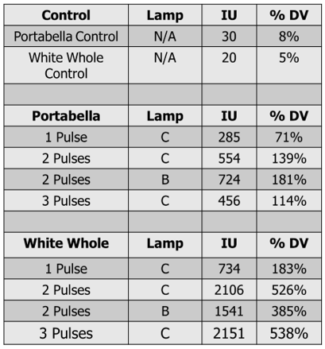
Testing
Following exposure, all mushrooms were shipped to Medallion Laboratories (Minneapolis, MN) for Vitamin D analysis.
Test results were expressed as Vitamin D total IU per 100 grams.
Depending upon the number of pulses, total Vitamin D in each mushroom ranged from 71% to 181% Daily Value for Portabella mushrooms and 183% to 538% for White Whole mushrooms.

Slide 11
Temperature Rise Study
Study of effect of temperature rise is important as it directly affects shelf life and avoids damage to the mushroom.
The effective rise in temperature based on number of pulses for Portabella and White Button mushrooms with a control based on the probe only is shown.
Only a few degree rise in temperature is observed.

Slide 12
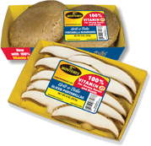
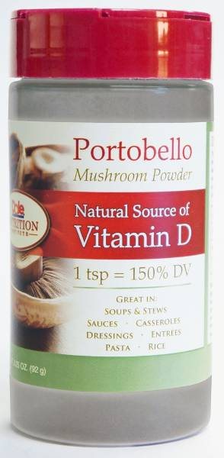
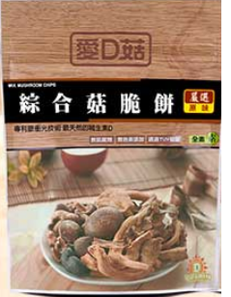
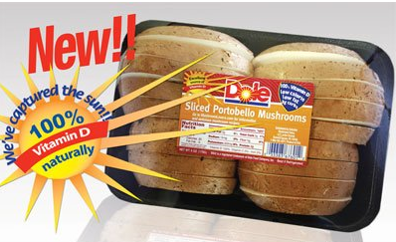
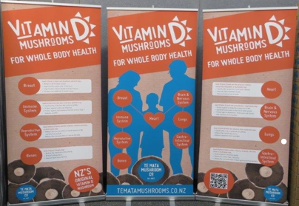
Commercialization
Many major companies have introduced Vitamin D-
enriched mushrooms into the market.
Post-treatment shelf life is good.
Creates an advantage for product sales.

Slide 13
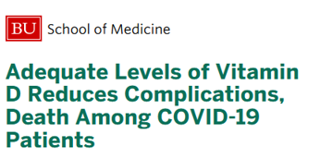
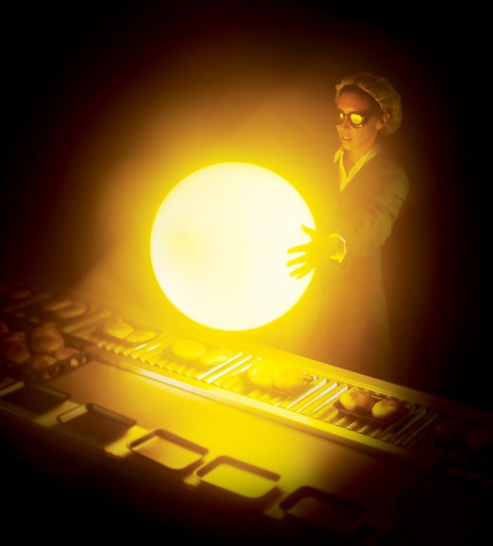
New Developments
Covid-19 and Vitamin D by Michael F. Holick, MD, PhD, Professor, Medicine; Boston University School of Medicine.
Mushroom Shelf-Life Extension without Chemicals.
Batch Processing with New Compact Integrated Pulsed Light System (CIXL).
Enhancing Powder Mushrooms with Vitamin D.
Lower Cost Equipment.
Pulsed Light Conveyor Treatment.
Floor Control With Pulsed Light.
Space and Air Sanitization with a High Dose of Sunlight.

Slide 14
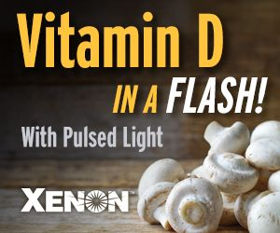
Conclusions
Vitamin D is an essential part of a healthy diet and commonly found in many foods.
High-energy pulses with short pulse durations reduce damage to the mushroom from heat.
The application is simple and being deployed commercially today.
XENON has the experience and expertise to be the technology facilitator.
Mushrooms, when flashed with XENON Pulsed Light, can generate more than 100% the daily value of Vitamin D within a single second.

Slide 15
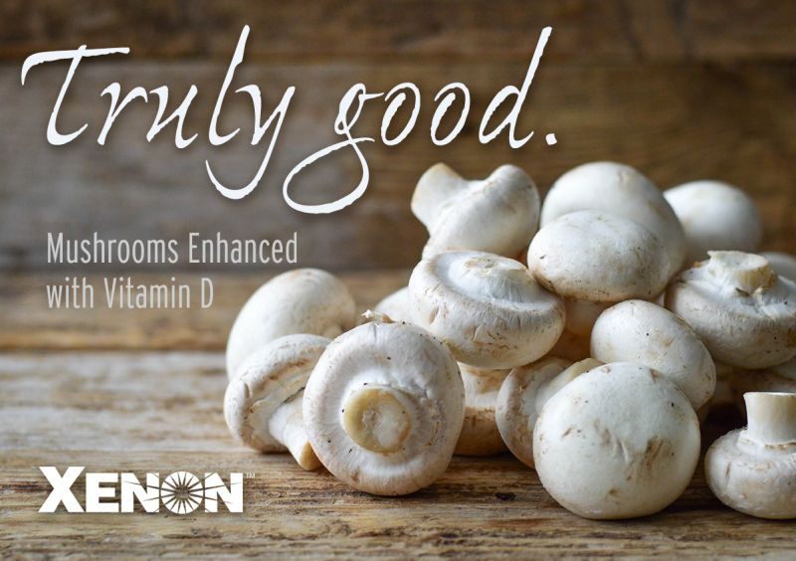




Thanks for your time…
… Any Questions?
Contact Us
XENON Corporation
37 Upton Drive, Wilmington, MA 01887
xenoncorp.com
marketing@xenoncorp.com

